Slide 1
CapStone Final Project – Opening a restaurant in Toronto

Slide 2
Agenda
Introduction
Description of the data
Methodology
Results
Discussion & recommendations
Conclusion

Slide 3
Introduction
Toronto is an international city, and all the residents are from all over the world. Lots of immigrants are running their own business in this city, running a restaurants is one of the most common choice.
There would be lots of chances that people would ask: I would like to open a restaurant in Toronto, how to do start?
The most two questions would be answered are:
1. Where should I open a restaurant?
2. What type of restaurant should I open ?
The following will explain how do we answer these questions.

Slide 4
Description of the data
To answer that, we need collect some data, a Toronto dataset include:
1. "Postal Code" ,"Borough", "Neighborhood", Location("Lat", "Lng") of current
restaurants.
2. These data will be collected from Foursquare API, and previous Coursera
module’s data, then these data will be analyzed to find out what type of
restaurants are there and how are they distributed in Toronto City.
3. We will put these data into table format and visualize these data in map, then
we can have a more straightforward view to find out the answer.

Slide 5
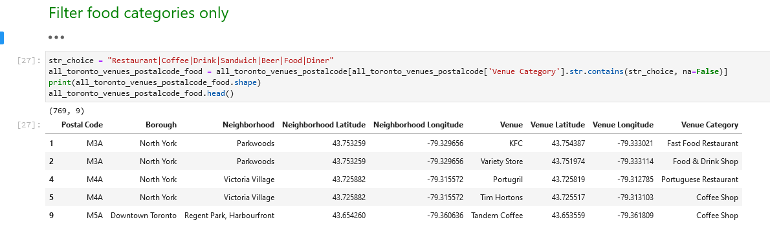
Methodology
I use 4square API and utilize the coursera module's Toronto neighborhood data to find out restaurant information

Slide 6
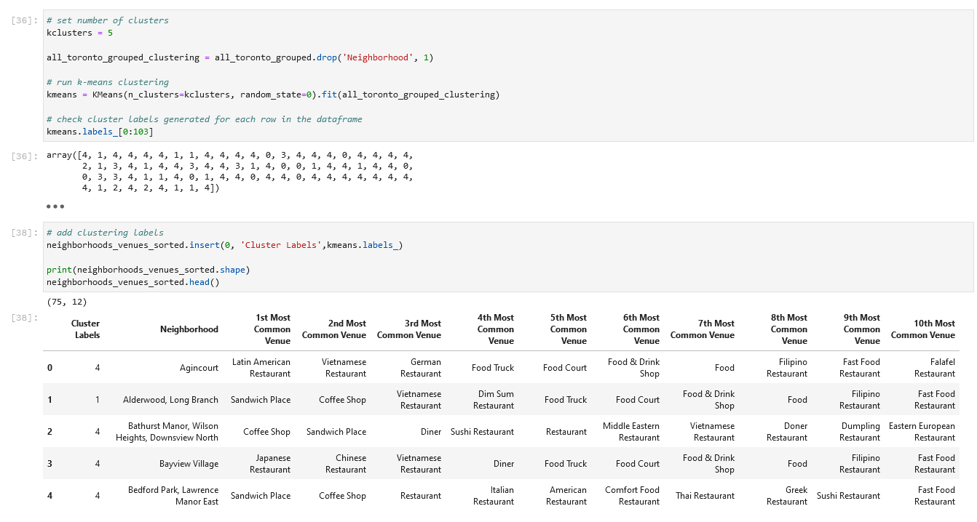
Methodology
by using k-means to cluster the neighborhood into 5 clusters, we can see what type of restaurants are most common in each cluster

Slide 7
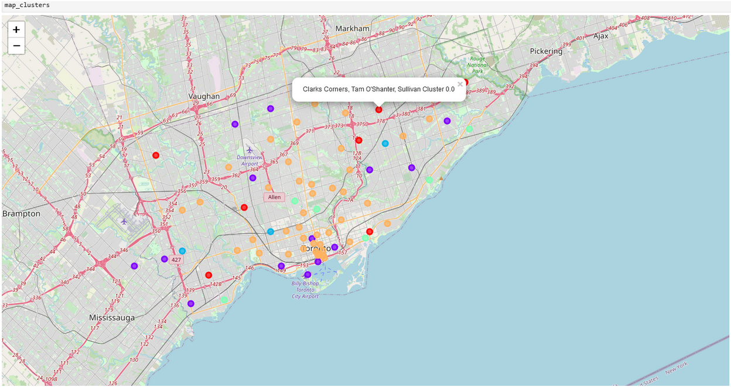
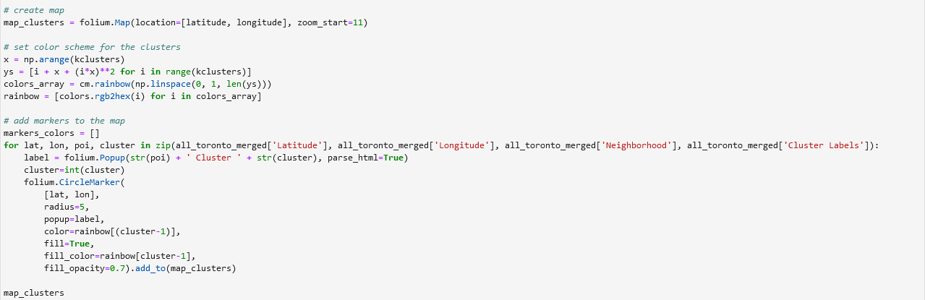
Results
Cluster location are visualized in map; we can see more clearly and straightforward to pick up a neighborhood we would like to open a restaurant.
Details of each cluster are in table format in the following pages.

Slide 8
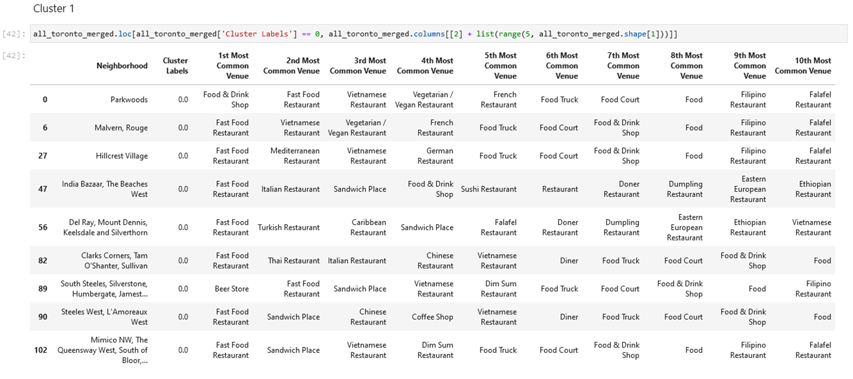
Results
Cluster-1 Table
(the ranking of most common venue of each neighborhood)

Slide 9
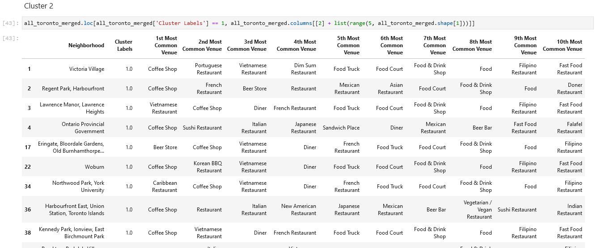
Results
Cluster-2 Table
(the ranking of most common venue of each neighborhood)

Slide 10
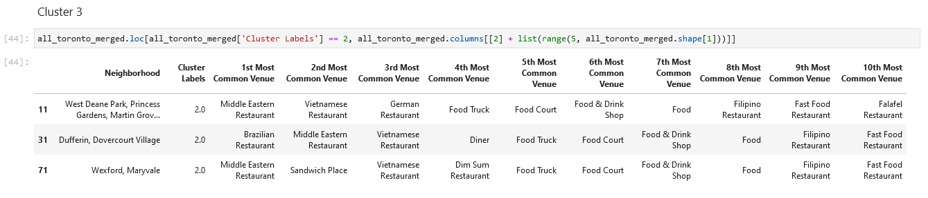
Results
Cluster-3 Table
(the ranking of most common venue of each neighborhood)

Slide 11
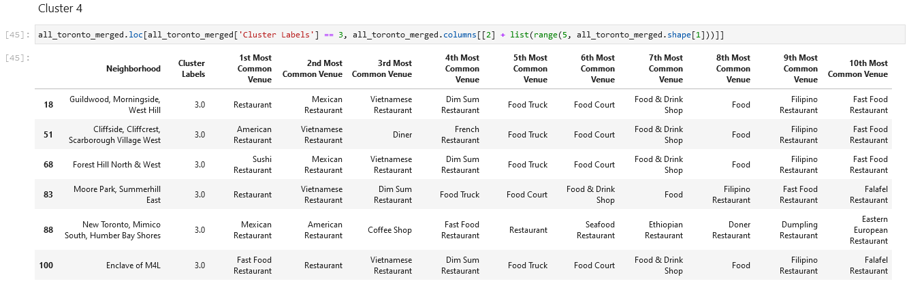
Results
Cluster-4 Table
(the ranking of most common venue of each neighborhood)

Slide 12
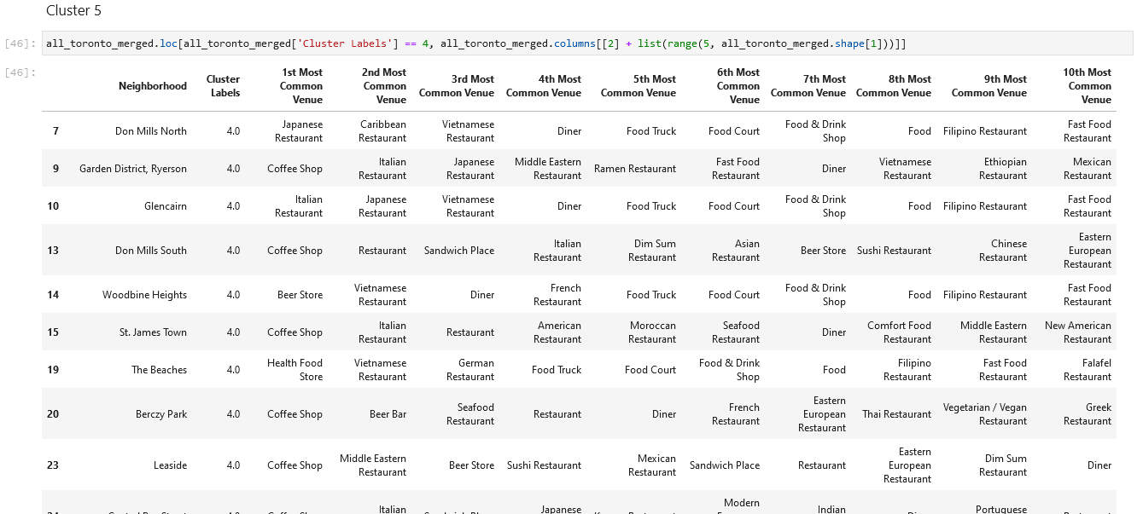
Results
Cluster-5 Table
(the ranking of most common venue of each neighborhood)

Slide 13
Discussion & recommendations
Now we have cluster information of each neighborhood and the ranking of the most common type of restaurants. In case you decide to open a restaurant in specific neighborhood, then you can reference these cluster information to choose a proper type of restaurant.
For example, in cluster 3, the 1st and 2nd common restaurant are Middle Eastern restaurant, Brazilian restaurant, Vietnamese restaurant and sandwich place, then probably you will not open a coffee shop here.
And vice versa, if you decide to open a coffee shop, cluster 2 and cluster 5 neighborhood maybe is your better choice.

Slide 14
Conclusion
These data analysis can give an overview of the current status of restaurants in Toronto to those people who would like to open a restaurant.
Also, these overview information can help to make a 1st step decision of what should do and what should not do.
You can interpret these data in other way when you have other additional information.

Slide 15
Thank You

